Slide 1
ENHANCED STRATEGIES
for
crisis response
APRIL 15, 2024

Slide 2
Part of the non-religious, international, suicide prevention network with over 400 centers in 40 countries
Created the world's first suicide hotline
Operates NYC's only 24-hour, anonymous & completely confidential crisis response hotline
Hotline staffed entirely by devoted, community volunteers
Samaritans’ NYC also has an education program & suicide bereavement support program.

Slide 3
Why are we
here?

Slide 4
SESSION OBJECTIVES
Understanding mechanisms and contributing factors for suicide.
Placing the crisis within a person’s experience.
Utilizing reality based assessments.

Slide 6
What we mean when we
say...
PREVENTION
INTERVENTION
POSTVENTION
happens BEFORE a crisis.
happens DURING a crisis.
happens AFTER a crisis.

Slide 7
01
There is no single cause for suicide.
SUICIDE DOES NOT DISCRIMINATE.
single
02
Suicide is an ambivalent act.
03
Suicide is an outcome-it is not a cause.

Slide 8
JOINER’S INTERPERSONAL THEORY OF SUICIDE
I am alone
Desire for
Suicide
I am a burden
Thwarted Belongingness
Perceived Burdensomness
Lethal
(or near lethal)
Suicide
Attempt
Capability
for Suicide
K.A. VanOrden et al. “Interpersonal Theory of Suicide.” Psychol Rev.
117(2)(2010):575

Slide 9
COMBINED INTERPERSONAL + INTERSECTIONAL THEORIES OF SUICIDE
Opara I, Assan MA, Pierre K, Gunn JF 3rd, Metzger I, Hamilton J, Arugu E. Suicide among Black Children: An Integrated Model of the Interpersonal-Psychological Theory of Suicide and Intersectionality Theory for Researchers and Clinicians. J Black Stud. 2020 Sep;51(6):611-631. doi: 10.1177/0021934720935641. Epub 2020 Jun 15. PMID: 34305168; PMCID: PMC8301214.

Slide 10
THE INTEGRATED MOTIVATIONAL–VOLITIONAL MODEL OF SUICIDAL BEHAVIOR
PRE-MOTIVATIONAL PHASE
VOLITIONAL PHASE
MOTIVATIONAL PHASE
Background factors that contribute to elevated risk.
Suicidal ideation and/or intent is formed.
Suicidal action taken.
personality traits, biological/ genetic risk factors, etc.
environment + social context
triggering life events
defeat / humiliation
entrapment
suicidal ideation + intent
suicidal behavior
Threat to Self Moderators
coping skills
social problem solving
autobiographical memory bias
Motivational
Moderators
thwarted belongingness
perceived burdensomness
resilience
goals
social support
Volitional
Moderators
access to lethal means
fearlessness re. death
prior attempts/ past behavior
exposure to suicide
impulsivity
sensitivity to pain
planning/ visualization of suicide/ death
O'Connor RC, Kirtley OJ. The integrated motivational-volitional model of suicidal behaviour. Philos Trans R Soc Lond B Biol Sci. 2018 Sep 5;373(1754):20170268. doi: 10.1098/rstb.2017.0268. PMID: 30012735; PMCID: PMC6053985.

Slide 11
THE 4-ITEM ENTRAPMENT SCALE SHORT-FORM (E-SF)
IDENTIFYING ENTRAPMENT
1. I often have the feeling that I would just like to run away
2. I feel powerless to change things
3. I feel trapped inside myself
4. I feel I’m in a deep hole I can’t get out of

Slide 12
MONITORING VOLITIONAL FACTORS

Slide 13
iceberg
The Iceberg Analogy
Personal experience
Sexual development
Exposure to violence
Learned coping styles
Relationships
Education
Culture & social heritage
Family beliefs & values
Family history
Socioeconomics
Diet/nutrition
Environment/geography
Genetics/predispositions

Slide 14
The crisis
experience

Slide 15
warning signs?
What are
Behaviors, affects and actions that indicate a someone might be considering suicide.
The key is to focus on changes in a person's usual behavior (especially when these changes are connected to a distressing event, a significant loss, or a major life change.)
TALK
FEELINGS
BEHAVIOR
Talking, writing or posting about wanting to die
Mentioning a plan or talking about ways they could die by suicide
A preoccupation with death or suicide
Expressing they feel trapped, in unmanageable pain, or a burden to others
Statements like: ‘I wish I was dead,’ ‘No one will miss me when I’m gone’ or ‘I wish I could just disappear.’
Hopeless, feeling they have no reason to live
Experiencing deep despair and sadness, feeling trapped
Increased anxiety
Shame, humiliation
Agitated, experiencing rage
Extreme changes in mood
Unbearable emotional or physical pain
Loss of interest
Relief, sudden improvement
Making preparations and/ or looking for ways to die by suicide
Withdrawing or isolating
Changes in eating and sleeping and patterns, hygiene/ appearance
Displaying extreme mood swings
Increased alcohol and/ or substance use
A sudden worsening at school/ job/ home, etc.
Increased impulsive reckless, and/or risk-taking behavior

Slide 16
risk factors?
What are
Characteristics related to a person's health, history and environment that increase the potential for suicide.
The presence and severity of risk factors differs from person to person over their lifetime.
HEALTH
ENVIRONMENT
Mental health conditions (particularly depression and other mood disorders)
Serious physical or chronic condition, prolonged physical pain
Terminal illness
Social isolation
Easy access to lethal means (especially guns)
Loss of a significant relationship (death, divorce, break-up, etc.)
High conflict or violent relationships
Loss of job, income, unemployment, benefits
Criminal/legal problems
Prolonged bullying, harassment or victimization
Limited access to health & mental health care
Cultural/religious beliefs that encourage suicide
Exposure to suicide (including (including a known person and through the media/ social media)
Stigma
HISTORY
Previous suicide attempt
Alcohol and/ or substance abuse
Family history of suicide
Family history of mental health conditions
Trauma
Physical/ sexual abuse and/ or neglect
Historical trauma
Discrimination
SAMARITANSNYC.ORG
2024

Slide 17
What are
protective factors?
Behaviors, skills, environments or relationships that reduce the likelihood of suicide and enhance resilience.
Protective factors help to counterbalance risk factors.
Supportive and caring family and friends
Reduced access to lethal means and enhanced lethal means safety
Connection to a community, school, work or supportive organization
Learned coping skills and behaviors
Access to medical and mental health care
Access to immediate and ongoing support
Cultural and/or religious beliefs that discourage suicide
protective factors
risk factors

Slide 18
Reality-based
assessments

Slide 19
MAKING REAL CONNECTIONS
How do you balance using the tool and determining degree of risk with authentic, empathetic support?
Notes:
How can we use the broader theories around mechanisms for suicide to approach implementation of C-SSRS?

Slide 20
Reality-based
assessments

Slide 21
Assessing suicide
ideation
QUESTIONS TO ASK
Is the person currently thinking about suicide? Or have they experienced or expressed suicidal thoughts in the recent past?
Does the person have a plan for how they would attempt suicide?
THE MORE A PERSON RESPONDS "YES", THE HIGHER THEIR RISK.
Do they have the means available to carry out their plan?
Has the person set a specific time to act on their plan?
If yes, when do they plan to act?
Has the person ever attempted suicide in the past or do they have a family member that did so?

Slide 22
CLINICAL IMPLICATIONS
Contributor to Suicide Attempt | Possible Intervention
Could not stand pain | Distress tolerance
Help seeking or wanted to express hostility | Assertiveness, communication skills
Could not generate alternative solutions | Problem solving
Intoxication | Psychoeducation or possible treatment for substance use disorder
Low mood | Mood disorder, depression?
Access to lethal means | Lethal means safety
Notes:
Active ingredients in effective interventions
• Explicit focus on suicidal risk
• Education
• Plan for coping with suicidal urges
• Distress tolerance
• Emotion regulation
• Problem-solving
• Family support, reduction in discord, monitoring, consistent discipline
• Service level: assertive follow-up, crisis response team, specific treatments for dual diagnosis and mood disorders, safety planning,
review of suicide deaths

Slide 23
Understanding lethal means
safety
MINUTES MATTER
Putting time and distance between a suicidal person and lethal means can help save a life.
+
TIME
DISTANCE

Slide 24
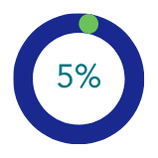
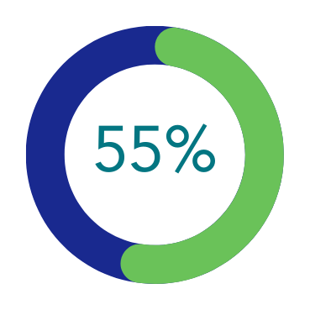
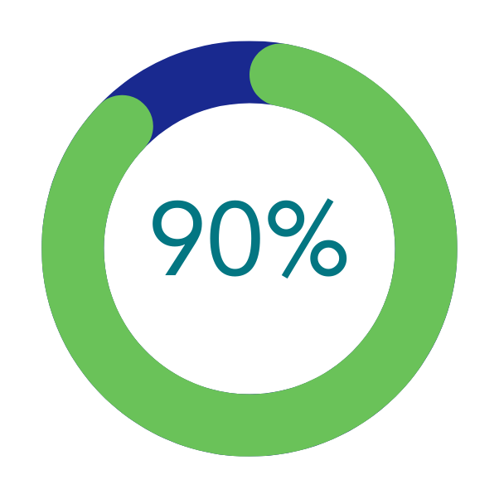
firearms
A closer look at
Less than 5% of suicide attempts involved firearms.
However, firearms account for 55% of all deaths by suicide.
90% of suicide attempts using a firearm are fatal.
All other methods for suicide combined are 4% fatal.

Slide 25
SAFE FIREARM STORAGE
A closer look at
LOCKED
firearms
Keep all firearms locked and secured.
SEPARATE
Access to firearms itself does not make a person suicidal. It makes someone who is already thinking about suicide more capable of dying.
Ensure firearms + ammunition are stored in separate places.
OFFSITE
Consider storing firearms offsite, especially if you are worried about yourself or someone else living in the home.
Notes:
“Lots of people have guns at home. What some people in your situation have done is store their guns away from home until they’re feeling better, or lock them and ask someone they trust to hold onto the keys. If you have guns at home, I’m wondering if you’ve thought about a strategy like that.”
“If temporarily storing them elsewhere is not an option, perhaps we can discuss some alternative ways to keep you safe until you’re feeling better.”

Slide 26
NEXT SESSION OBJECTIVES:
Effective communication for connecting with person in crisis.
Recognizing how stigma can impact a provider’s ability to respond to a person in crisis hinder prevention.
Mastering the mindful provision of referrals.

Slide 27
THANK YOU FOR PARTICIPATING TODAY!
bit.ly/SamsResourceHub
SAMARITANS’ RESOURCE HUB
bit.ly/SamsResourceHub

